Slide 1
While loops

Slide 2
Outline
In this lesson, we will:
  Describe looping statements and their implementation in C++
  Introduce non-terminating loops
  Implement two versions examining the Collatz conjecture
  See how to limit the number of iterations of a loop
  Implement the factorial function
  Walk through the steps of converting an algorithm described in English to a program
    We will use the greatest-common divisor algorithm

Slide 3
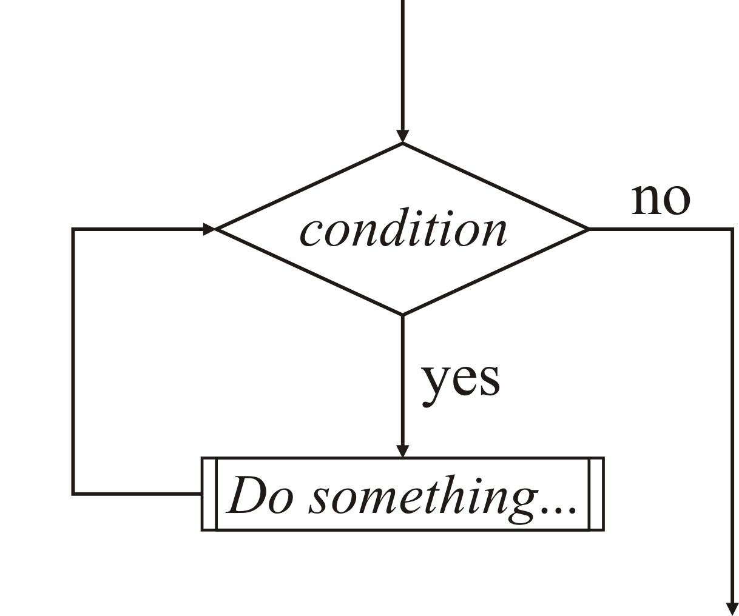
Looping statements
We previously looked at:
  Executing blocks of statements
  Conditionally executing a block of statements based on a Boolean-valued condition
We will now look at the C++ implementation of a looping statement

Slide 4
Looping statements
We implemented conditional statements based on a condition being evaluated to true
if ( condition ) {
// Do something...
} else {
// Do something else...
}

Slide 5
Looping statements
A looping statement is implemented based on repeatedly executing a block of statements so long as a condition is true
while ( Boolean-valued condition ) {
The looped block of statements
- to be executed as long as the
condition is 'true'
}
// Continue executing here as soon as the
// condition evaluates to 'false'

Slide 6
Looping statements
Because this state block is repeatedly executed (i.e., looped) while a condition is true, we refer to such a statement as a “while loop”
while ( Boolean-valued condition ) {
The looped block of statements
- to be executed as long as the
condition is 'true'
}
// Continue executing here as soon as the
// condition evaluates to 'false'

Slide 7
Looping statements
The easiest while loop is one that does so forever:
    #include <iostream>
    int main();
    int main() {
    // @non-terminating@
    while ( true ) {
    std::cout << "Hello world!" << std::endl;
    }
    return 0;
    }

Slide 8
Looping statements
Such non-terminating while loops are used in real-time systems that respond to external events:
    int main();
    int main() {
    // @non-terminating@
    while ( true ) {
    // Wait for an event
    // Respond to that event
    }
    // Technically, we never get here
    return 0;
    }

Slide 9
Collatz conjecture
Normally, however, the condition is affected by the action of the looped block of statements
We’ll look at one example based on an interesting mathematical quandary:
  The Collatz conjecture says that if you start with a number a, do the following:
    If it is odd, multiply it by three and add one
    If it is even, divide it by two
  The Collatz conjecture says that this sequence will ultimately reduce to the cycle 1, 4, 2, 1, 4, 2, 1, …

Slide 10
Collatz conjecture
We can try this with any number of initial values
1
2, 1
3, 10, 5, 16, 8, 4, 2, 1
4, 2, 1
5, 16, 8, 4, 2, 1
6, 3, 10, 5, 16, 8, 4, 2, 1
7, 22, 11, 34, 17, 52, 26, 13, 40, 20, 10, 5, 16, 8, 4, 2, 1
8, 4, 2, 1
9, 28, 14, 7, 22, 11, 34, 17, 52, 26, 13, 40, 20, 10, 5, 16, 8, 4, 2, 1
10, 5, 16, 8, 4, 2, 1
11, 34, 17, 52, 26, 13, 40, 20, 10, 5, 16, 8, 4, 2, 1
12, 6, 3, 10, 5, 16, 8, 4, 2, 1

Slide 11
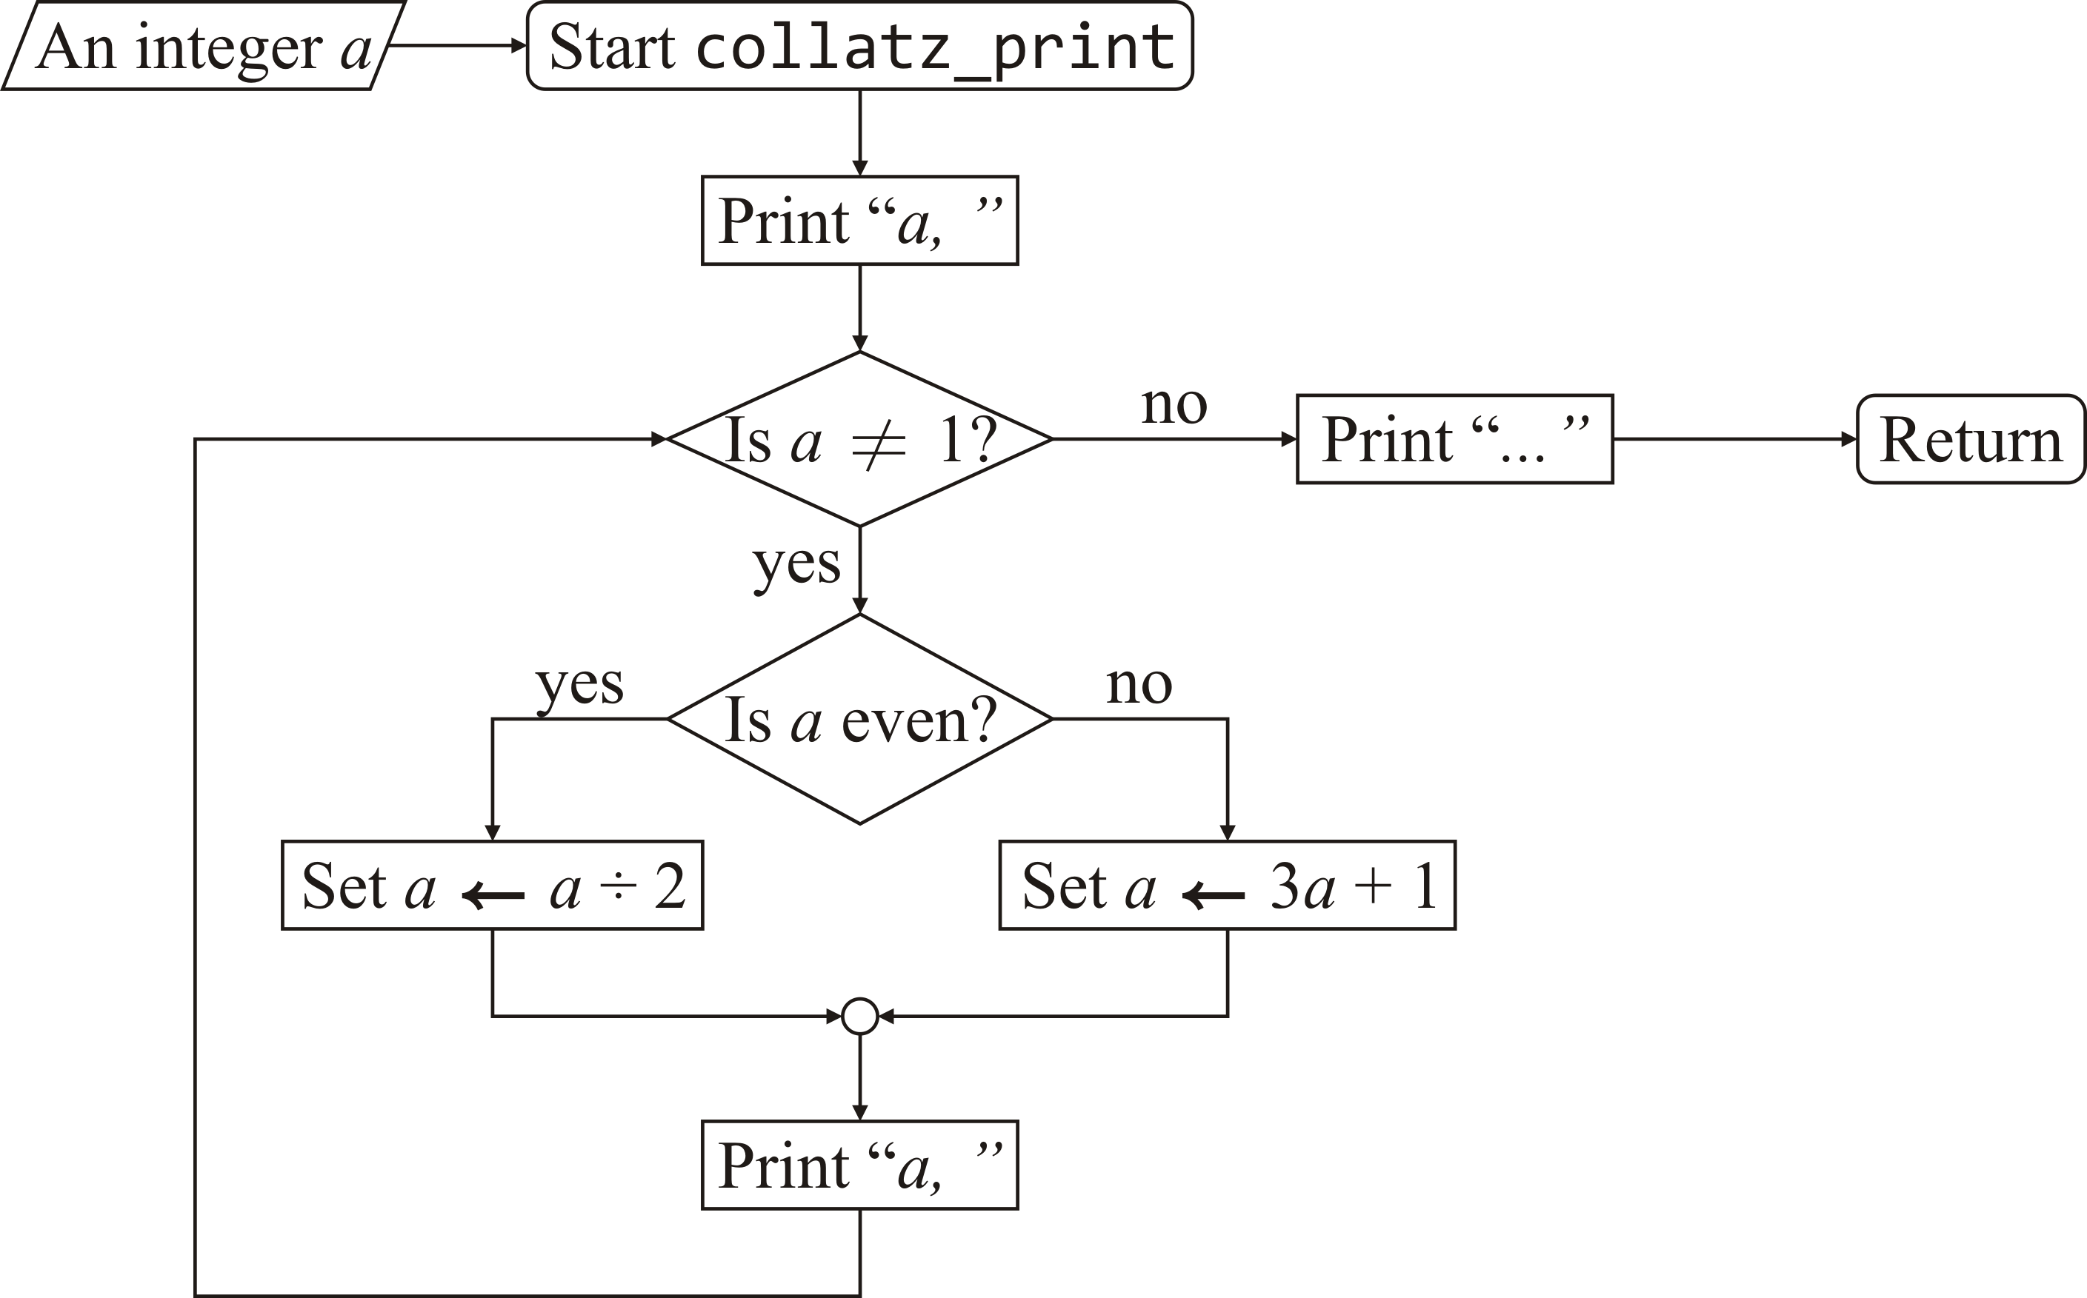
Collatz conjecture
Write a function collatz_print(…) that takes a positive integer a and prints out the sequence of integers until it reaches one, in which case, terminate with "..."
  Print “a, ”
  If a ≠ 1,
    If a is even,
      Divide a by two,
      Otherwise, set a ← 3a + 1
    Print “a, ”
    Go to Step 2.
  Print “…”

Slide 12
Collatz conjecture
An implementation of this algorithm is:
void collatz_print( unsigned int a );
void collatz_print( unsigned int a ) {
std::cout << a << ", ";
while ( a != 1 ) {
if ( (a % 2) == 0 ) {
a /= 2;
} else {
a = 3*a + 1;
}
std::cout << a << ", ";
}
std::cout << "..." << std::endl;
}
Question: What happens if
the argument passed is 0?

Slide 13
Collatz conjecture
Try it yourself:
    #include <iostream>
    #include <cassert>
    // Function declarations
    void collatz_print( unsigned int a );
    // Function definitions
    void collatz_print( unsigned int a ) {
    assert( a != 0 );
    std::cout << a << ", ";
    while ( a != 1 ) {
    if ( (a % 2) == 0 ) {
    a /= 2;
    } else {
    a = 3*a + 1;
    }
    std::cout << a << ", ";
    }
    std::cout << "..." << std::endl;
    }
    int main() {
    collatz_print( 1970 );
    return 0;
    }

Slide 14
Collatz conjecture
Mathematicians aren’t so interested in the actual sequences, but rather the number of terms in the sequence until you get to 1
  For example,
    27, 82, 41, 124, 62, 31, 94, 47, 142, 71, 214, 107, 322, 161, 484, 242, 121, 364, 182, 91, 274, 137, 412, 206, 103, 310, 155, 466, 233, 700, 350, 175, 526, 263, 790, 395, 1186, 593, 1780, 890, 445, 1336, 668, 334, 167, 502, 251, 754, 377, 1132, 566, 283, 850, 425, 1276, 638, 319, 958, 479, 1438, 719, 2158, 1079, 3238, 1619, 4858, 2429, 7288, 3644, 1822, 911, 2734, 1367, 4102, 2051, 6154, 3077, 9232, 4616, 2308, 1154, 577, 1732, 866, 433, 1300, 650, 325, 976, 488, 244, 122, 61, 184, 92, 46, 23, 70, 35, 106, 53, 160, 80, 40, 20, 10, 5, 16, 8, 4, 2, 1
    171, 514, 257, 772, 386, 193, 580, 290, 145, 436, 218, 109, 328, 164, 82, 41, 124, 62, 31, 94, 47, 142, 71, 214, 107, 322, 161, 484, 242, 121, 364, 182, 91, 274, 137, 412, 206, 103, 310, 155, 466, 233, 700, 350, 175, 526, 263, 790, 395, 1186, 593, 1780, 890, 445, 1336, 668, 334, 167, 502, 251, 754, 377, 1132, 566, 283, 850, 425, 1276, 638, 319, 958, 479, 1438, 719, 2158, 1079, 3238, 1619, 4858, 2429, 7288, 3644, 1822, 911, 2734, 1367, 4102, 2051, 6154, 3077, 9232, 4616, 2308, 1154, 577, 1732, 866, 433, 1300, 650, 325, 976, 488, 244, 122, 61, 184, 92, 46, 23, 70, 35, 106, 53, 160, 80, 40, 20, 10, 5, 16, 8, 4, 2, 1
112 iterations
125 iterations

Slide 15
Collatz conjecture
Write a function collatz(…) that takes a positive integer n and returns the number of steps required until we get to one:
unsigned int collatz( unsigned int a );
unsigned int collatz( unsigned int a ) {
unsigned int num_iterations{0};
while ( a != 1 ) {
++num_iterations;
if ( (a % 2) == 0 ) {
a /= 2;
} else {
a = 3*a + 1;
}
}
return num_iterations;
}

Slide 16
Collatz conjecture
Notice the function declarations:
void collatz_print( unsigned int n );
unsigned int collatz( unsigned int n );
Could we not just give the same name?
  After all, we had other functions with the same name
Problem: The C++ compiler cannot choose based on return type only
  The compiler only chooses based on the types of any arguments
  If two functions have identical parameter types, they must have different names

Slide 17
Collatz conjecture
We could create a second loop that queries the user for an argument:
#include <iostream>
int main();
void collatz_print( unsigned int n );
int main() {
bool keep_going{true};
while ( keep_going ) {
unsigned int n{};
std::cout << "Enter a positive integer ('0' to quit): ";
std::cin >> n;
if ( n == 0 ) {
keep_going = false;
} else {
collatz_print( n );
}
}
return 0;
}

Slide 18
Collatz conjecture
Problem: what happens if we pass our function the argument 0?
  While the specification may require the argument to be greater than zero, you must explicitly check:
unsigned int collatz( unsigned int n ) {
assert( n >= 1 );
unsigned int num_iterations{0};
// Other code...
return num_iterations;
}
unsigned int collatz( unsigned int n ) {
if ( n == 0 ) {
return 0;
} else {
unsigned int num_iterations{0};
// Other code...
return num_iterations;
}
}

Slide 19
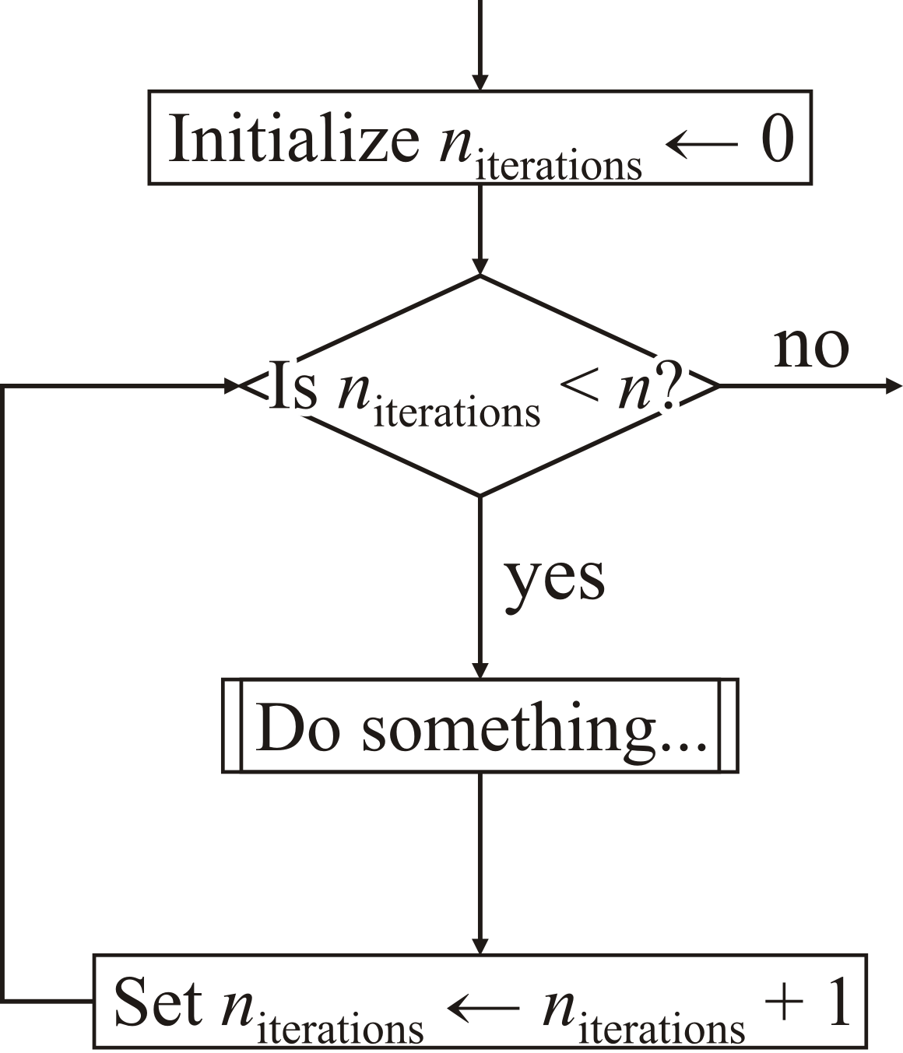
Counting
Suppose we want a loop to run exactly n times
  Track of how often the loop has executed with a local variable n_{iterations}
  Initialize a local variable n_{iterations} ← 0
  As long as n_{iterations} < n,
    execute the block of statements associated with the loop,
    increment n_{iterations}, and
    return to Step 2.

Slide 20
Counting
Here is a while loop that executes a fixed number of times
  This assumes the value of max_{iterations} is never changed…
  unsigned int num_iterations{0};
  while ( num_iterations < max_iterations ) {
  // Do something...
  ++num_iterations;
  }
Once num_iterations == max_iterations, we have executed the block of statements the required number of times

Slide 21
Factorial function
Suppose we want to calculate n!
  Because 0! = 1! = 1, we could start with this value, and then keep multiplying this by 2, then 3, and so on up until n:
  Initialize a result r ← 1 and a variable k ← 2
  If k ≤ n,
    multiply r by k: r ← kr,
    increment k ← k + 1, and
    return to Step 2.
  Return r

Slide 22
Factorial function
Here is an implementation of the factorial function:
  unsigned int factorial( unsigned int n );
  unsigned int factorial( unsigned int n ) {
  unsigned int result{1};
  unsigned int k{2};
  while ( k <= n ) {
  result *= k;
  ++k;
  }
  return result;
  }

Slide 23
How to design a while loop
Suppose you are attempting to implement an algorithm where you repeated apply a number of steps
  How do you make the transition from manual to programmatic?
Recommendation:
  Do the algorithm on paper—in full
  Examine the steps you took, and determine:
    What steps were repeated?
    What condition caused you to stop repeating the steps?

Slide 24
The greatest-common divisor
From secondary school, you saw that the algorithm for calculating the greatest common denominator (gcd)
  You are asked to find the gcd of 8008 and 8085
  You first note that 8085 > 8008
  Next, you find that 8085 ÷ 8008 equals 1 with a remainder of 77
  Next, you find that 8008 ÷ 77 equals 104 with a remainder of 0
  From this, you are told that the gcd is 77

Slide 25
The greatest-common divisor
Let’s try again:
  You are asked to find the gcd of 1583890 and 85800
  You first note that 1583890 > 85800
  Next, you find that 1583890 ÷ 85800 equals 18 with a remainder of 39490
  Next, you find that 85800 ÷ 39490 equals 2 with a remainder of 6820
  Next, you find that 39490 ÷ 6820 equals 5 with a remainder of 5390
  Next, you find that 6820 ÷ 5390 equals 1 with a remainder of 1430
  Next, you find that 5390 ÷ 1430 equals 3 with a remainder of 1100
  Next, you find that 1430 ÷ 1100 equals 1 with a remainder of 330
  Next, you find that 1100 ÷ 330 equals 3 with a remainder of 110
  Next, you find that 330 ÷ 110 equals 3 with a remainder of 0
  From this, you are told that the gcd is 110

Slide 26
The greatest-common divisor
At each step, we had a pair of numbers
  Call the m and n
For the initial step, we set
  the larger number to be m, and
  the smaller number to be n
After that, we repeatedly
  calculated the remainder r when dividing m ÷ n, and
  if r = 0, we are done, and n is the gcd,
  otherwise, we repeat with the pair n and r
    That is, we set m ← n and then we set n ← r
Remember: when you calculate m ÷ n,
the remainder r must always satisfy n > r ≥ 0

Slide 27
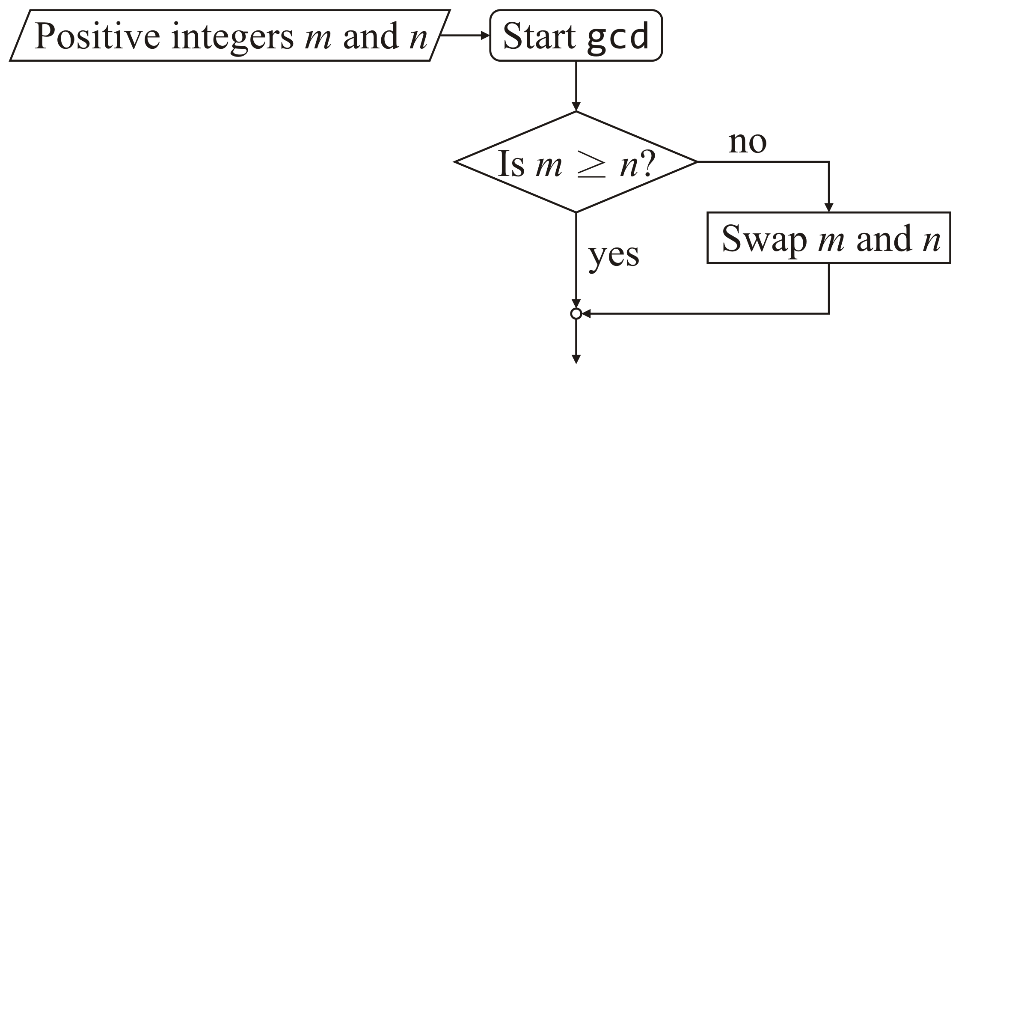
The greatest-common divisor
Let’s look at the first steps:
  At each step, we had a pair of numbers
    Call them m and n
  For the initial step, we set
    the larger number to be m, and
    the smaller number to be n
Problem: We are doing something if the condition is false:
  We execute a block of statements when m ≥ n is false
Let’s use the complementary condition:
  This is equivalent to executing the statements when m < n is true

Slide 28

The greatest-common divisor
Thus, we swap the parameters m and n if m < n

Slide 29
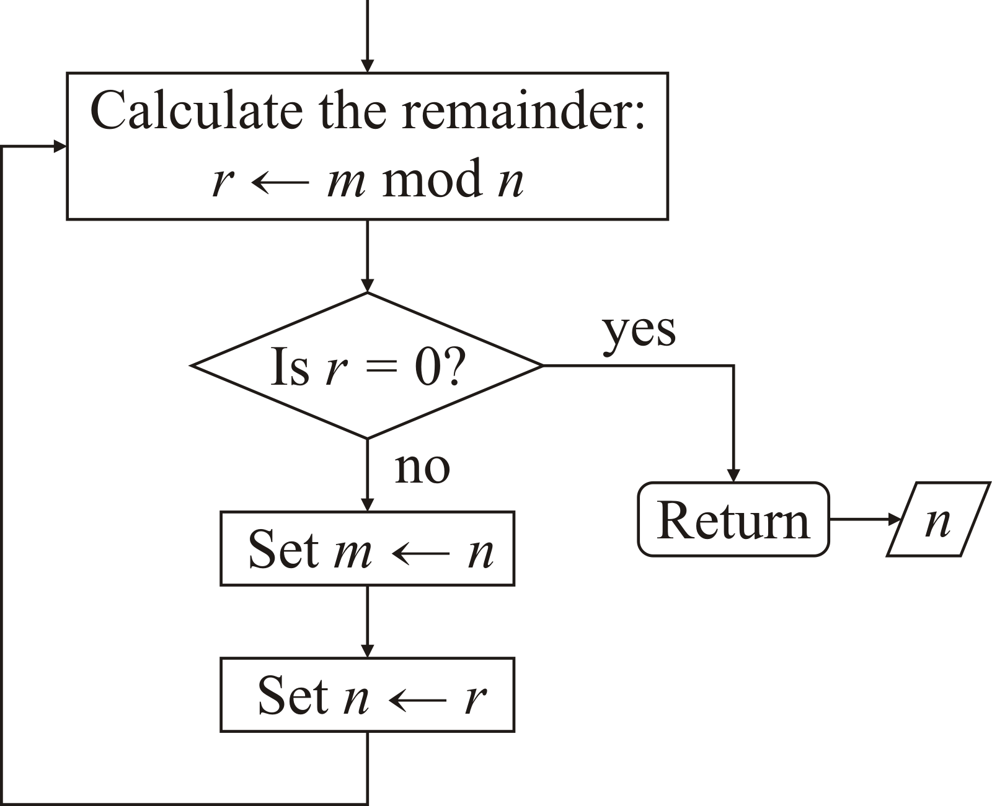
The greatest-common divisor
The next steps we perform are that we
  calculate the remainder r, and
  if r = 0, we are done, and n is the gcd,
  otherwise, we repeat with the pair n and r
    That is, we set m ← n and then we set n ← r
Problem: this is not in the form a while loop

Slide 30
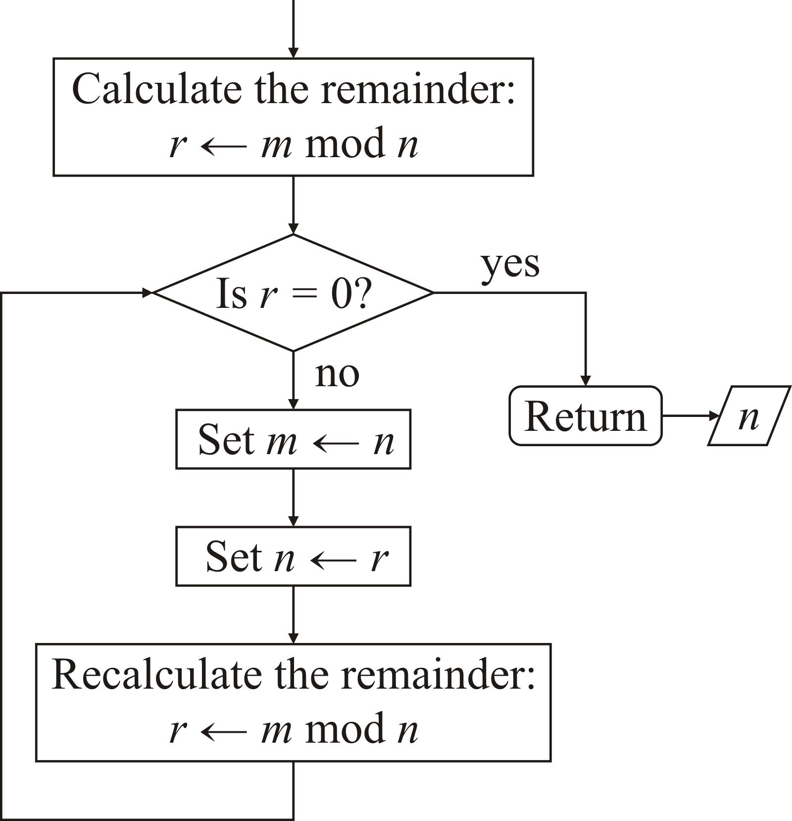
The greatest-common divisor
First, a while loop must return to the condition
  We can repeat the first statement at the end

Slide 31
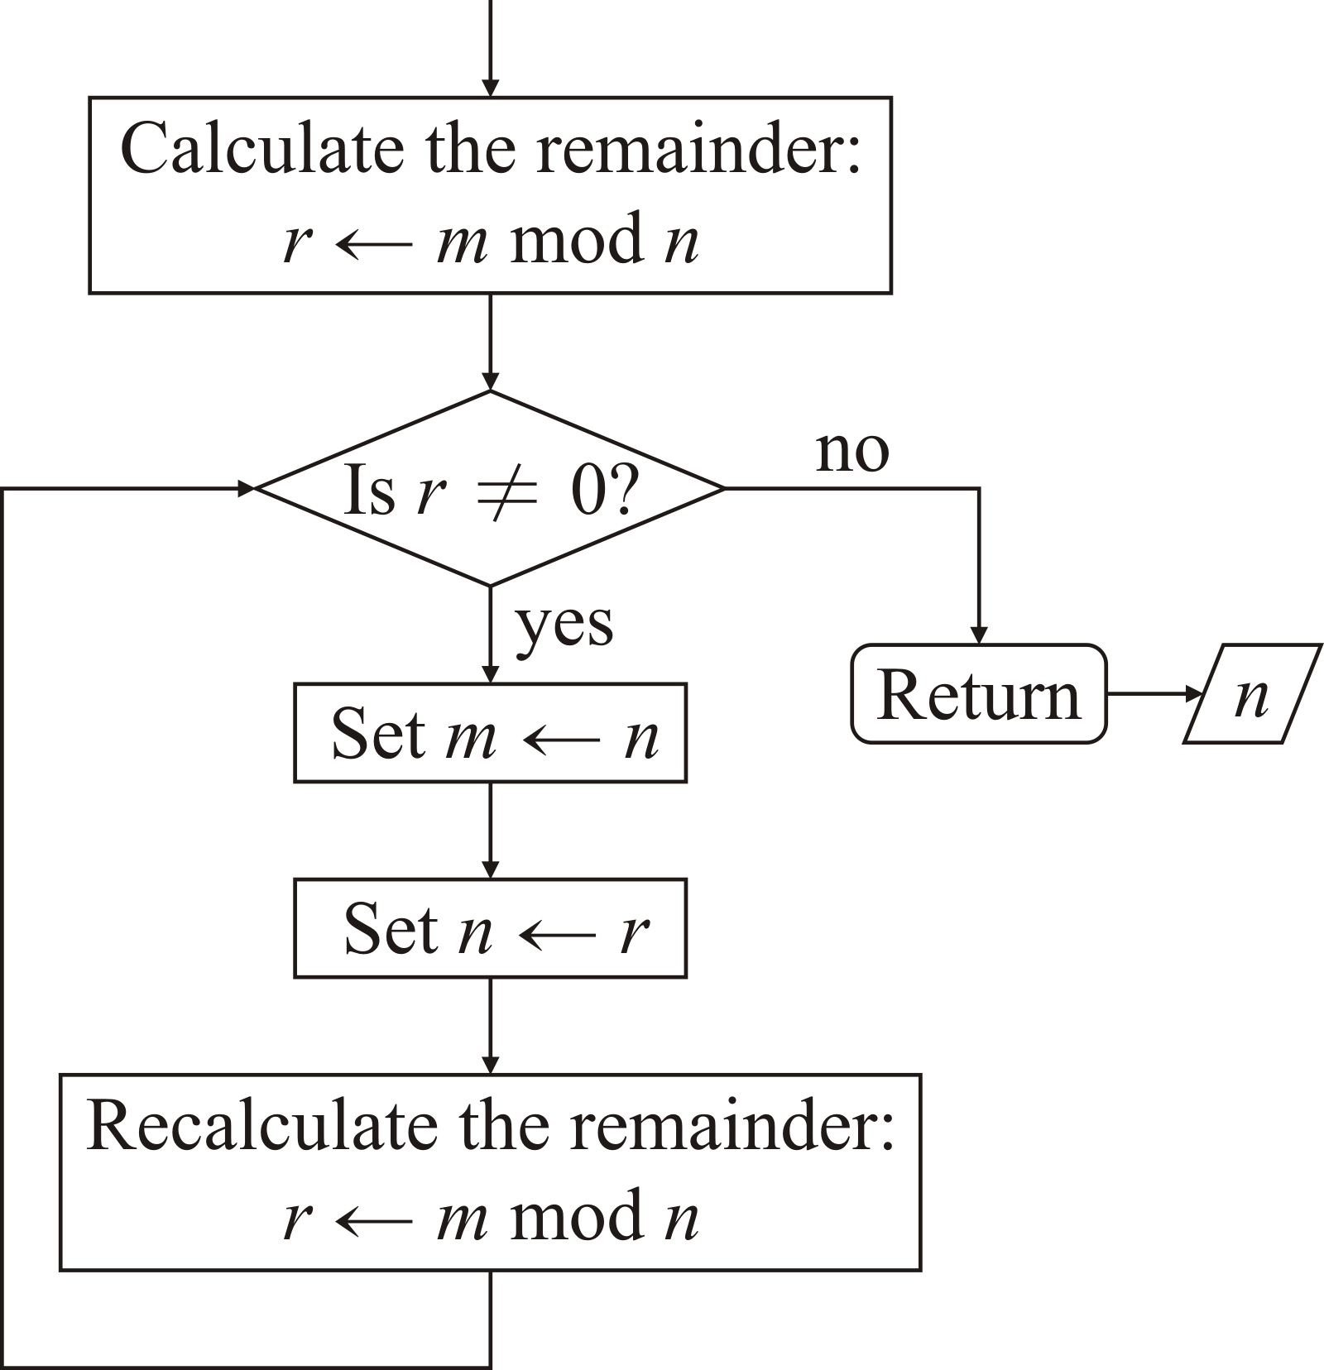
The greatest-common divisor
Second, the condition for looping must evaluate to true
  Continuing while r = 0 is false is equivalent to
  continuing while r ≠ 0 is true

Slide 32
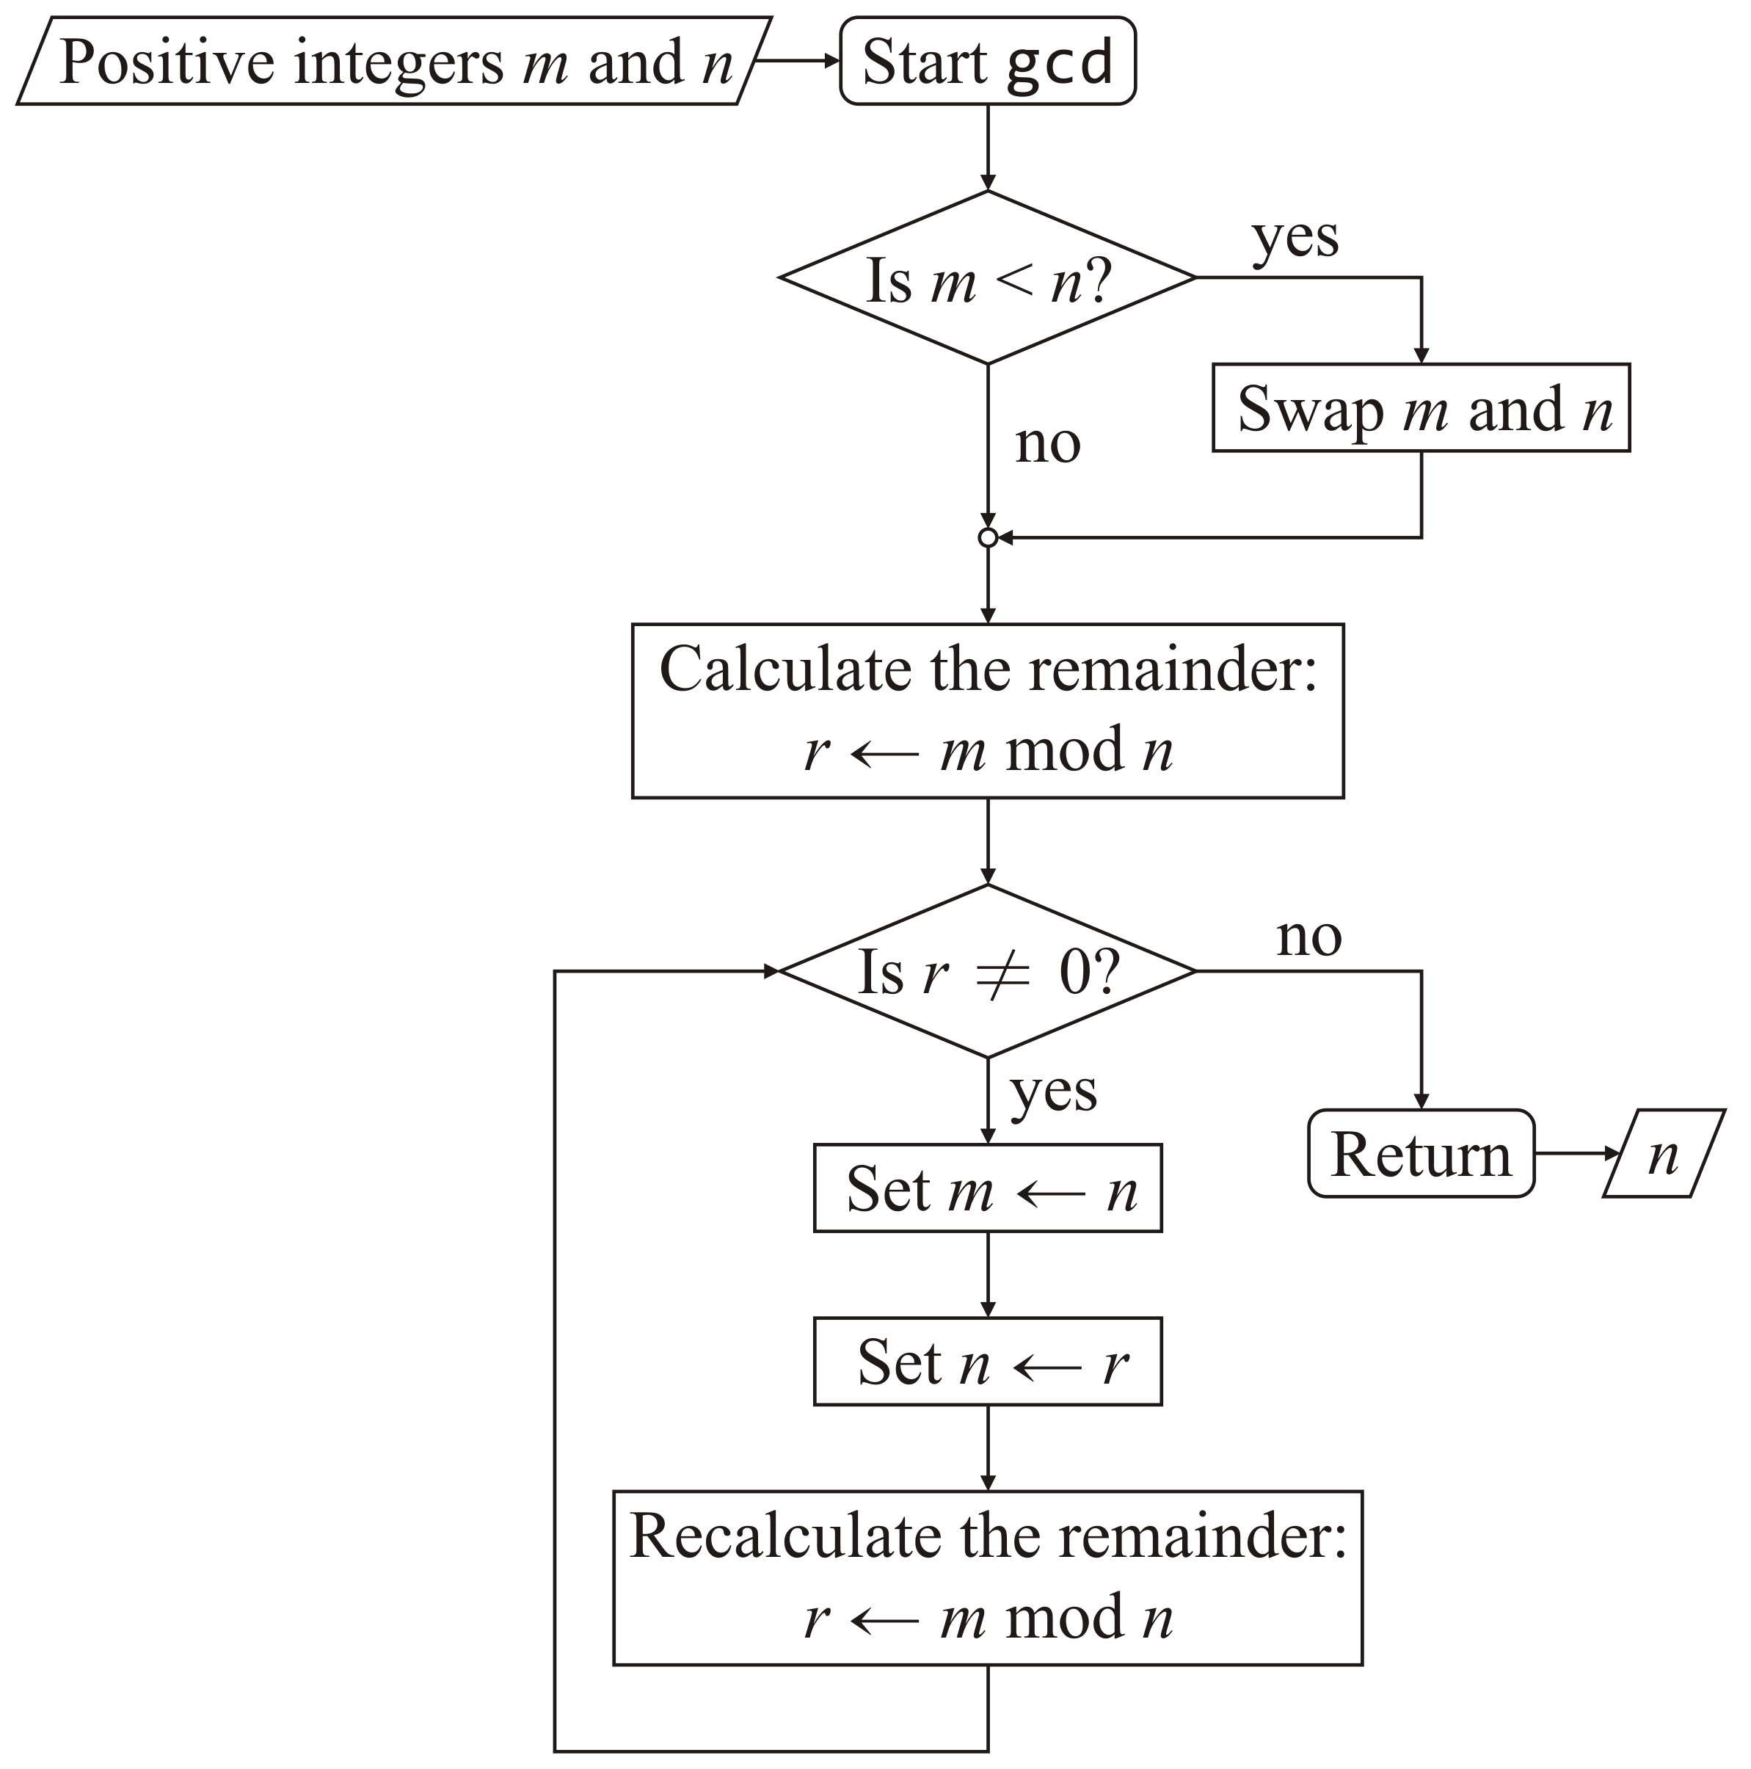
The greatest-common divisor
Thus, our final flow chart is:

Slide 33
The greatest-common divisor
Programming this:
    unsigned int gcd( unsigned int m, unsigned int n ) {

Slide 34
The greatest-common divisor
Programming this:
    unsigned int gcd( unsigned int m, unsigned int n ) {
    if ( m < n ) {
    unsigned int tmp{m};
    m = n;
    n = tmp;
    }

Slide 35
The greatest-common divisor
Programming this:
    unsigned int gcd( unsigned int m, unsigned int n ) {
    if ( m < n ) {
    unsigned int tmp{m};
    m = n;
    n = tmp;
    }
    unsigned int r{m % n};

Slide 36
The greatest-common divisor
Programming this:
    unsigned int gcd( unsigned int m, unsigned int n ) {
    if ( m < n ) {
    unsigned int tmp{m};
    m = n;
    n = tmp;
    }
    unsigned int r{m % n};
    while ( r != 0 ) {
    }

Slide 37
The greatest-common divisor
Programming this:
    unsigned int gcd( unsigned int m, unsigned int n ) {
    if ( m < n ) {
    unsigned int tmp{m};
    m = n;
    n = tmp;
    }
    unsigned int r{m % n};
    while ( r != 0 ) {
    m = n;
    n = r;
    r = m % n;
    }

Slide 38
The greatest-common divisor
Programming this:
    unsigned int gcd( unsigned int m, unsigned int n ) {
    if ( m < n ) {
    unsigned int tmp{m};
    m = n;
    n = tmp;
    }
    unsigned int r{m % n};
    while ( r != 0 ) {
    m = n;
    n = r;
    r = m % n;
    }
    return n;
    }

Slide 39
Infinite loop?
Question:
  What do you do if you accidentally execute a program that has an infinite loop?
Solution:
  In Eclipse, there is a stop button that becomes active when a program is executing
  Other ides will have similar features
  At the console, press Ctrl-C

Slide 40
Summary
Following this lesson, you now
  Understand how to implement while loops in C++
  Understand how to limit the number of times the corresponding statement block is executed
  Seen how to implement various functions requiring looping statements:
    The Collatz conjecture
    The factorial function
  Understand how to convert a description of an algorithm to one that you can program
    The example we used was the greatest-common divisor
  Know how to terminate a program in an infinite loop

Slide 41
References
[1] Wikipedia
https://en.wikipedia.org/wiki/While_loop
[2] cplusplus.com
http://www.cplusplus.com/doc/tutorial/control/
[3] tutorialspoint
https://www.tutorialspoint.com/cplusplus/cpp_while_loop.htm

Slide 42
Acknowledgments
Proof read by Dr. Thomas McConkey and Charlie Liu.

Slide 43



Colophon
These slides were prepared using the Georgia typeface. Mathematical equations use Times New Roman, and source code is presented using Consolas.
The photographs of lilacs in bloom appearing on the title slide and accenting the top of each other slide were taken at the Royal Botanical Gardens on May 27, 2018 by Douglas Wilhelm Harder. Please see
https://www.rbg.ca/
for more information.

Slide 44
Disclaimer
These slides are provided for the ece 150 Fundamentals of Programming course taught at the University of Waterloo. The material in it reflects the authors’ best judgment in light of the information available to them at the time of preparation. Any reliance on these course slides by any party for any other purpose are the responsibility of such parties. The authors accept no responsibility for damages, if any, suffered by any party as a result of decisions made or actions based on these course slides for any other purpose than that for which it was intended.

